Slide 1
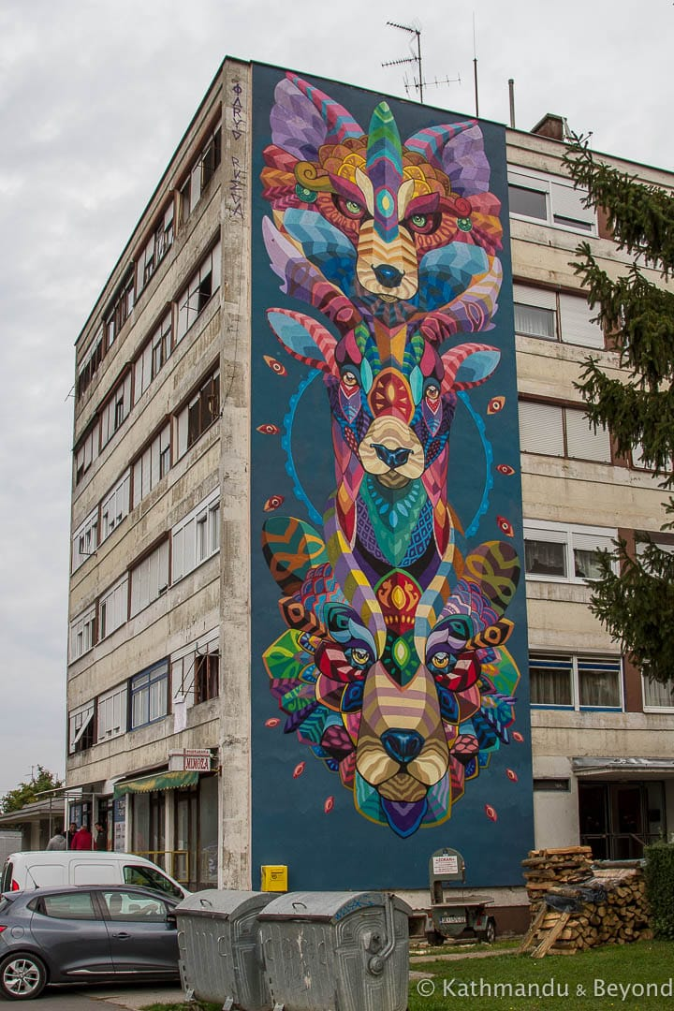
Limerick Street Art Maps

Slide 2
Aim of the project
With this app, it is easy to explore street art all through the Street.
Promote the Street Art
Share the information to other people about the street Art.
Get more attention to the artist.
Tourisms attraction.

Slide 3
Promote the culture of society
Flexible to use and add information.
Connecting people with Street art.
Recommendation Artwork

Slide 4
Implementation
The app will be implemented using React Native, because it can be run in both Android and iOS.
GPS coordinates.

Slide 5
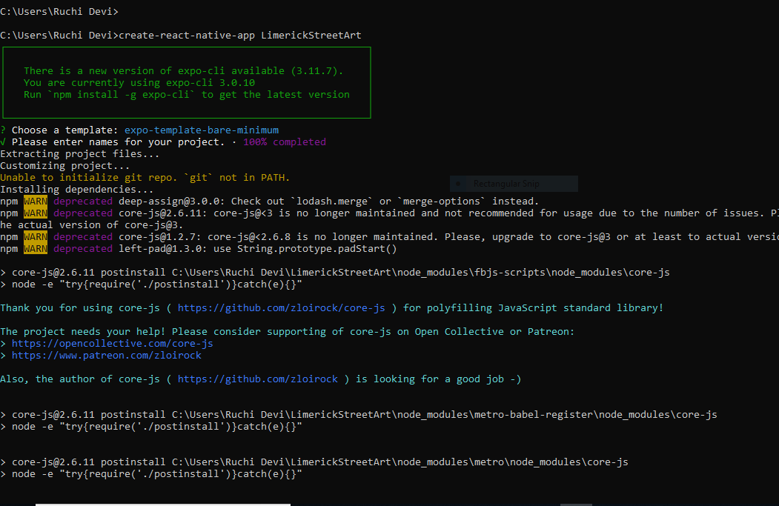
Installation of project

Slide 6
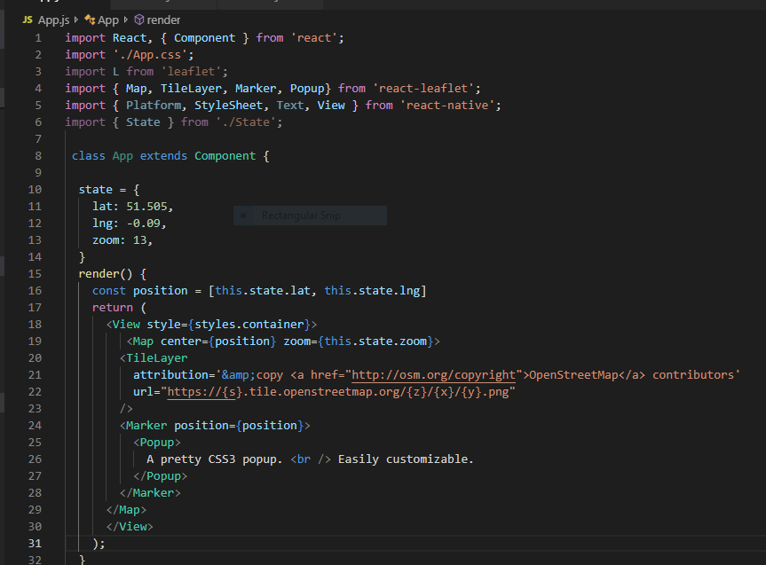

Slide 7
Question and Answer

